Slide 1
GSBA 511: Managerial Economics
Prof. Akbulut
Chapter 6

Slide 2
You design websites for local businesses. You charge $200 per website, and currently sell 12 websites per month.
Your costs are rising (including the opportunity cost of your time), so you consider raising the price to $250.
The law of demand says that you won’t sell as many websites if you raise your price. How many fewer websites? How much will your revenue fall, or might it increase?

Slide 3
Chapter 6: Outline
The Price Elasticity of Demand and Its Measurement
The Determinants of the Price Elasticity of Demand
The Relationship between the Price Elasticity of Demand and Total Revenue

Slide 4
Price Elasticity of Demand
Elasticity: Percentage change in one variable resulting from a 1-percent increase in another.
Price Elasticity of Demand: Percentage change in quantity demanded of a good resulting from a 1-percent increase in its price.

Slide 5
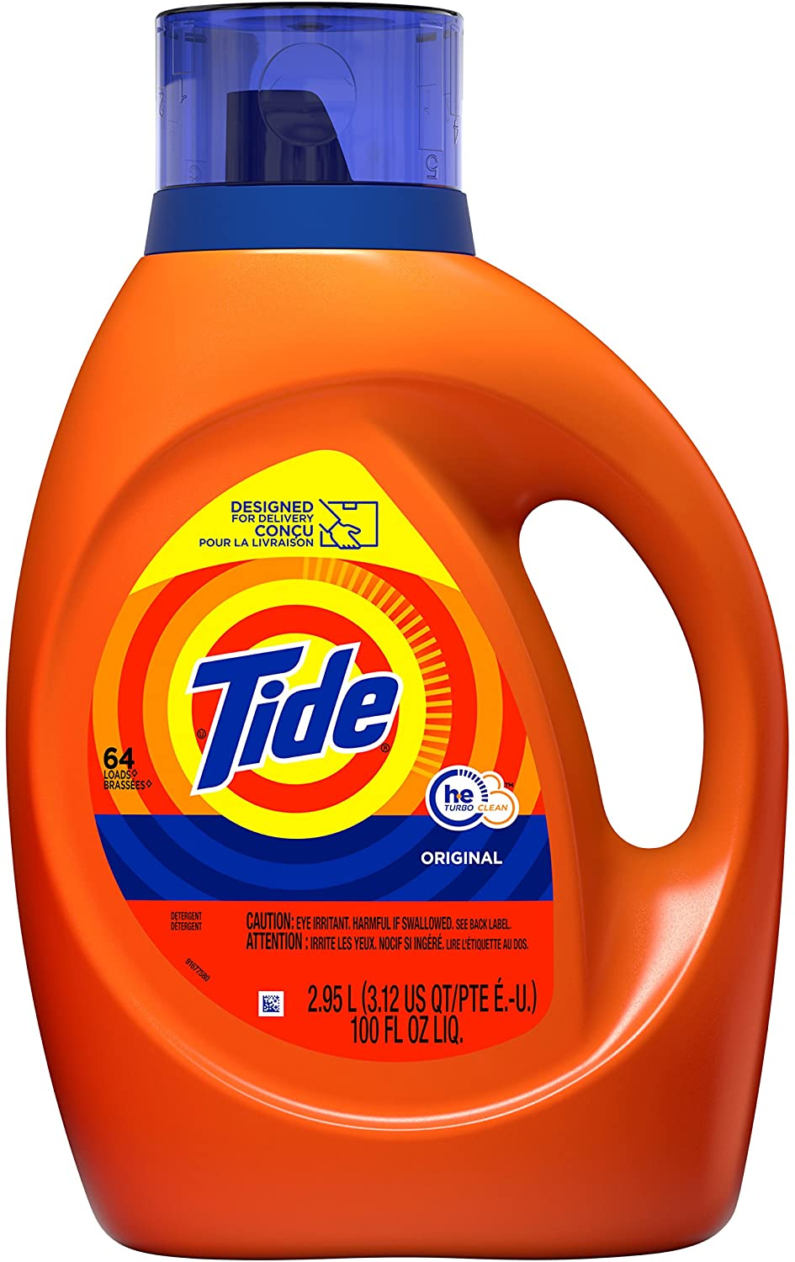

Estimated real-world price elasticities of demand
Type of Elasticity | Estimate
Relatively elastic (|E|>1)
Tide (liquid detergent) | -3.92
Automobiles | -1.95
Unitary elastic (|E|=1)
Grapes | -1.18
Shoes | -0.9
Relatively inelastic (|E|<1)
Milk | -0.04
Gasoline | -0.06

Slide 6
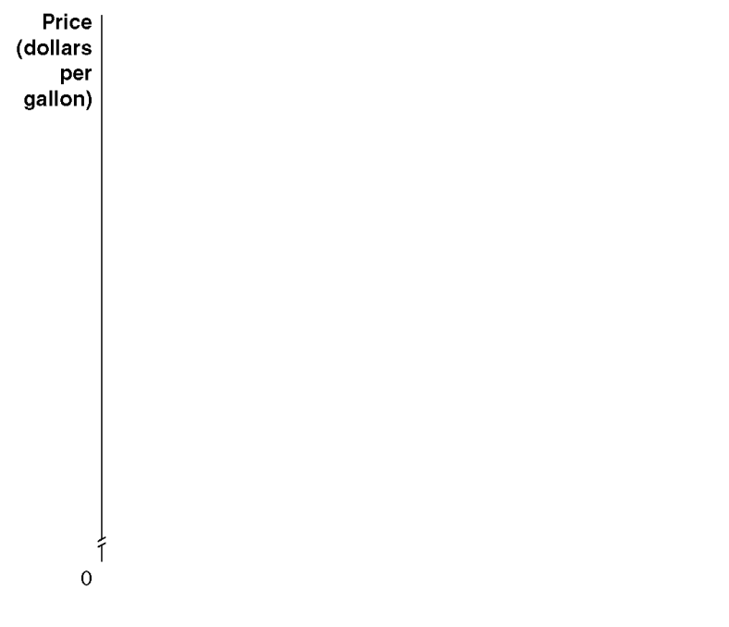
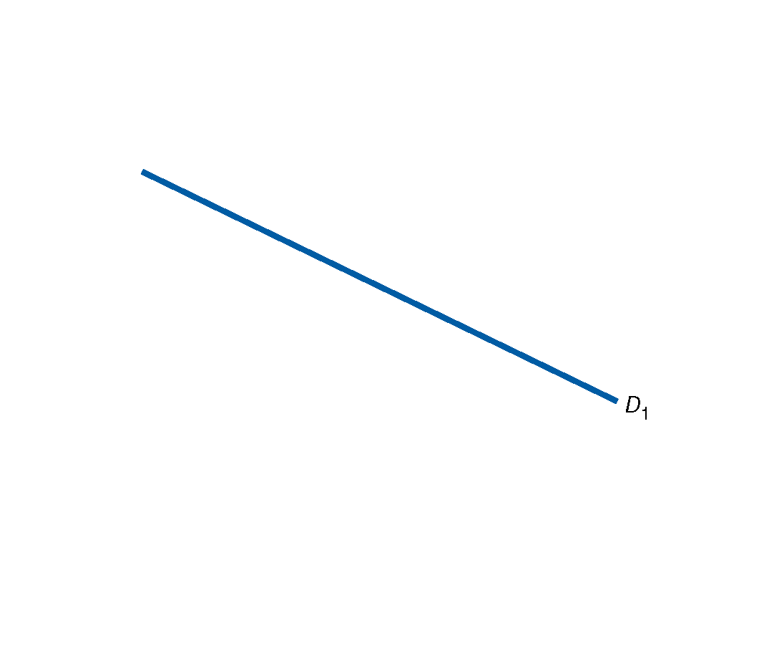
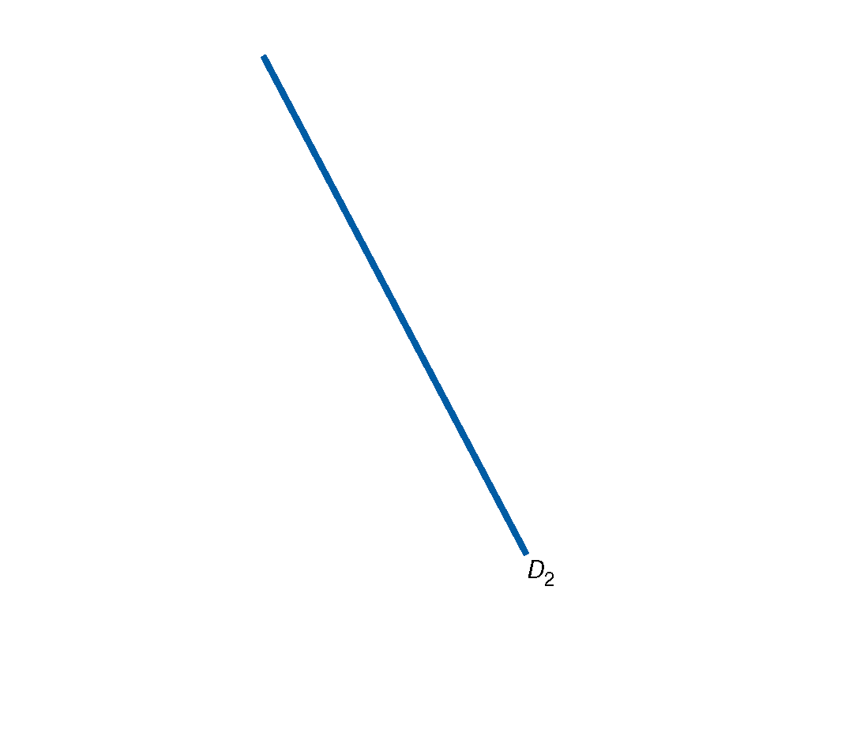

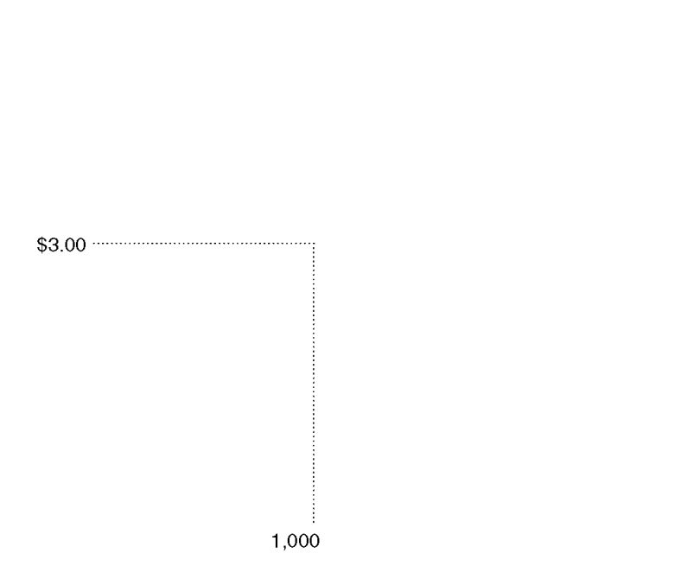
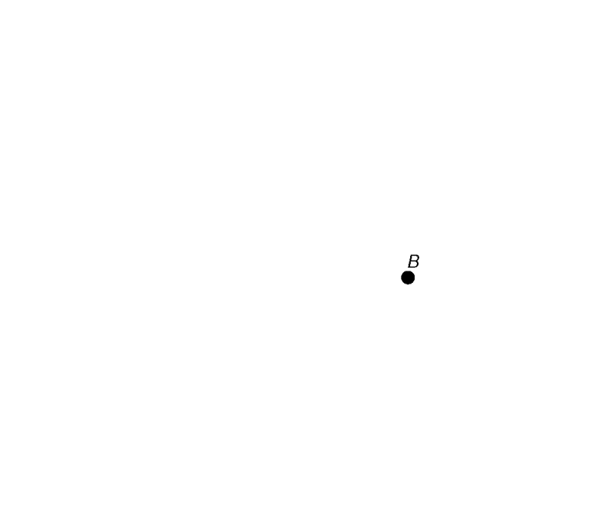
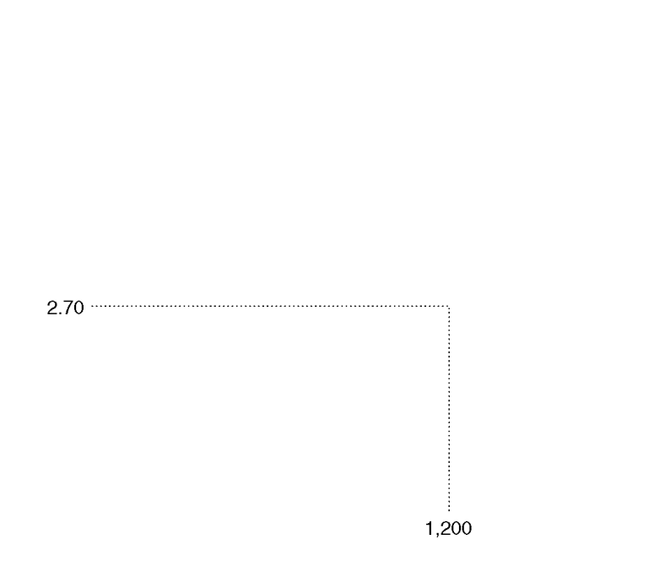
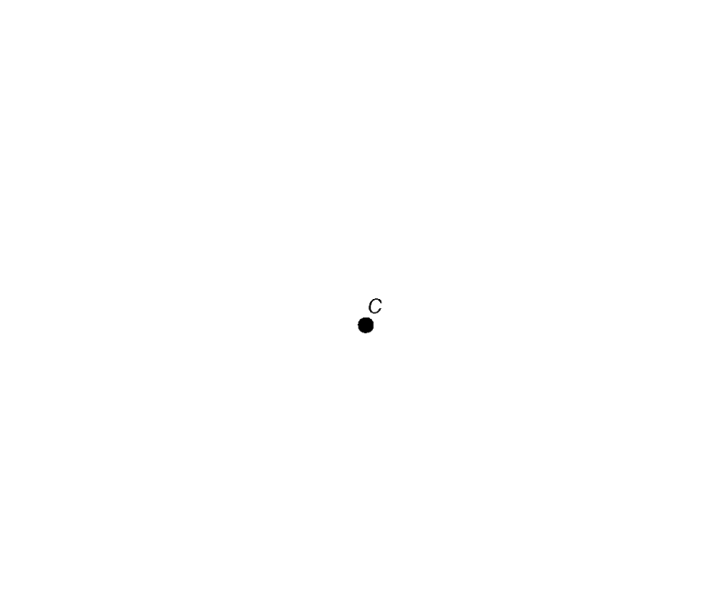
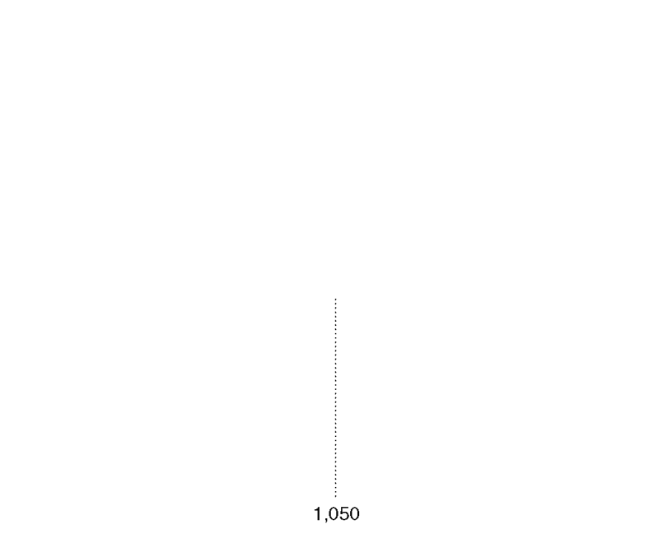
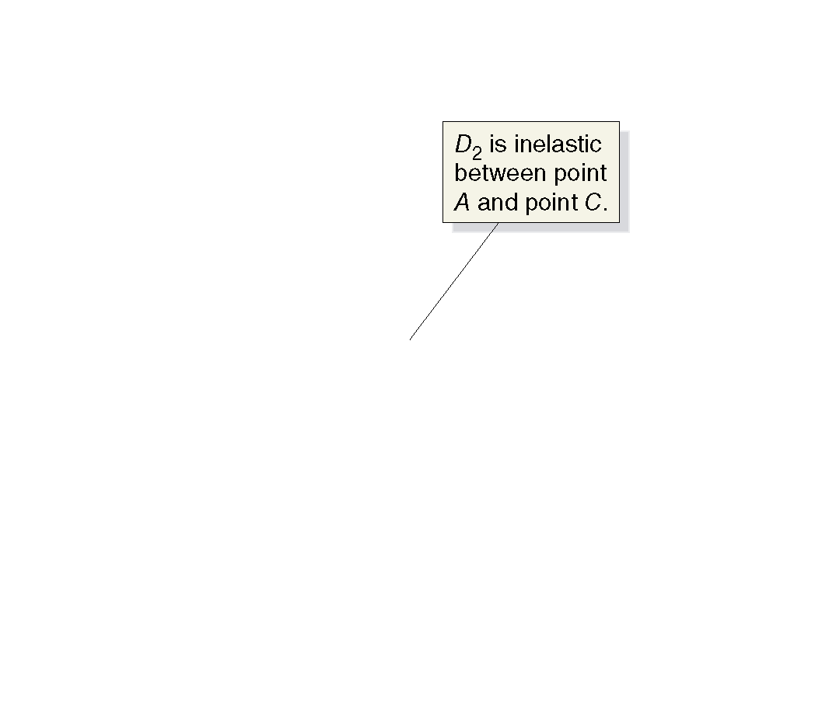
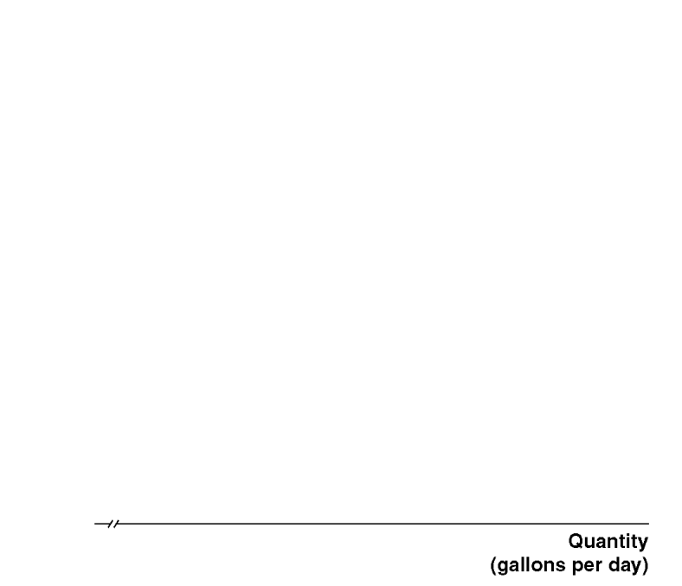
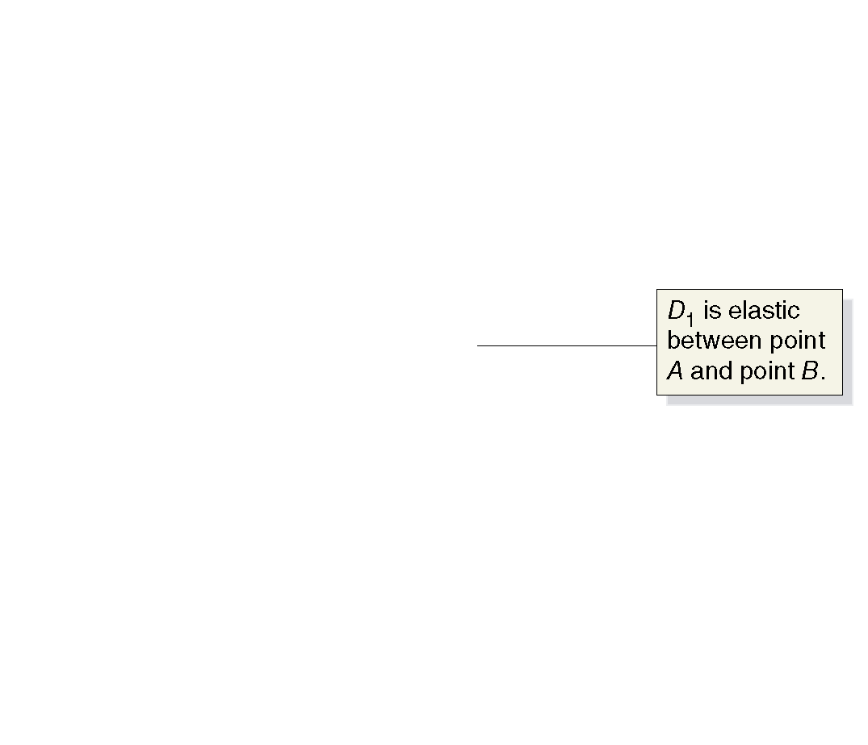
Elastic and Inelastic Demand

Slide 7
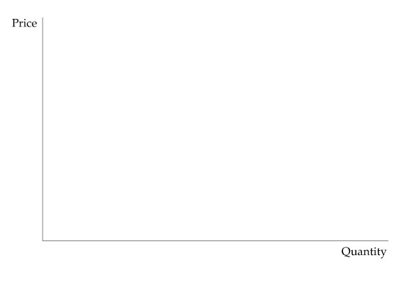
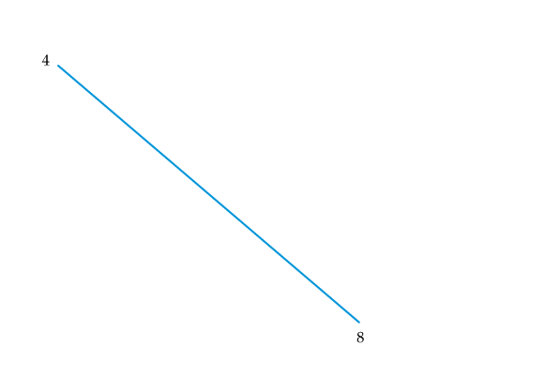
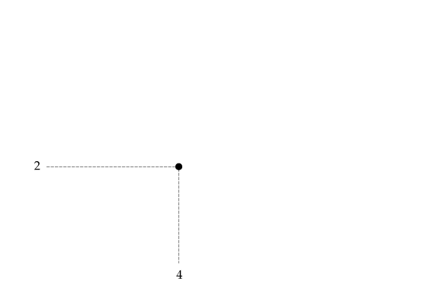
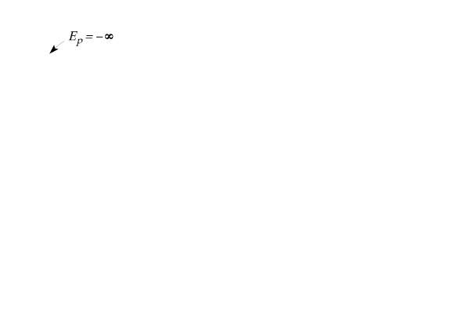
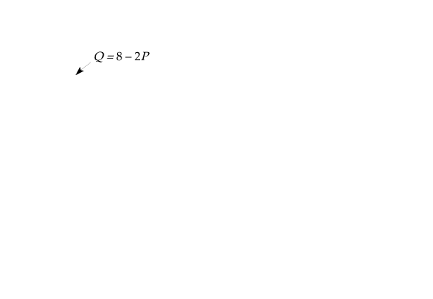
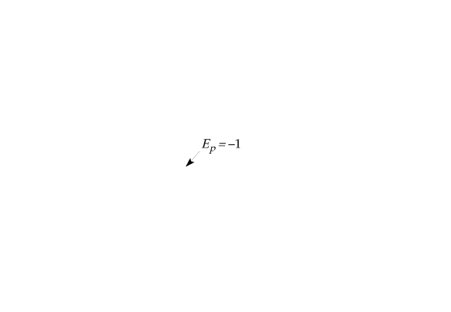
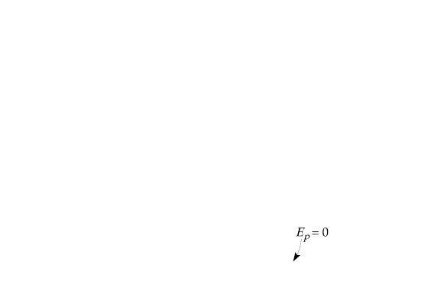
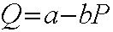
Price Elasticity of Demand
Linear Demand Curve
The price elasticity of demand depends not only on the slope of the demand curve but also on the price and quantity.
The elasticity, therefore, varies along the curve as price and quantity change. Slope is constant for this linear demand curve.

Slide 8
Calculating Elasticity at a Point
If we have the demand function, we can calculate elasticity at a given point.
ΔQ/ΔP = - .2
But that’s not elasticity.
We need to have P and Q, as well.
Suppose that P=85, I = 300, and PY = 50 then Q = 48
So, elasticity, at that point, was
Ep= (-.2) (85/48) = -.35

Slide 9
Calculating Elasticity using Midpoint Formula
If we have only two observations from a demand schedule, then we must calculate elasticity over that range.
Percentage change will be different if you move from a point A on the demand curve to point B, or from point B to A.
To avoid that problem, we use the midpoint formula for percentage changes.
percentage change = (A-B) / [(A+B)/2]

Slide 10
Calculating Elasticity using Midpoint Formula
P | Q
20 | 12
22 | 10
%∆Q= (10-12)/11
%∆P = (22-20)/21
Price Elasticity of Demand = -(2/11) / (2/21)
= - 21/11 = - 1.91

Slide 11
Price Elasticity and Total Revenue
Lost revenue from decreasing price (ΔP/ΔQ)(Q₁)
Elastic demand: price and total revenue move in opposite directions.
P
Additional revenue from increasing quantity (P₂)
P₁
P₂= P₁-ΔP
Inelastic demand: price and total revenue move in same direction.
Lost revenue
Gain
Q
Q₁
Q₁+1

Slide 12
P
Elastic demand
Unitary elasticity at midpoint
Inelastic demand
Demand curve
Q
TR
Total revenue maximized where demand is unitary elastic
Total revenue curve
Q

Slide 13
Estimating Price Elasticity of Demand
We can see that knowing the price elasticity of demand would be very useful for a firm. But how can a firm know this information?
For a well-established product, economists can use historical data to estimate the demand curve.
To calculate the price elasticity of demand for a new product, firms often rely on market experiments.

Slide 14
What determines price elasticity of demand?

Slide 15


EXAMPLE 1: Breakfast cereal vs. Sunscreen
The prices of both of these goods rise by 20%. For which good does Q^{d} drop the most? Why?
Breakfast cereal has close substitutes, so buyers can easily switch if the price rises.
Sunscreen has no close substitutes, so consumers would probably not buy much less if its price rises.
Lesson: Price elasticity is higher when close substitutes are available.

Slide 16


EXAMPLE 2: “Jeans” vs. “Clothing”
The prices of both goods rise by 20%. For which good does Q^{d} drop the most? Why?
For a narrowly defined good such as blue jeans, there are many substitutes.
There are fewer substitutes available for broadly defined goods.
Lesson: Price elasticity is higher for narrowly defined goods than broadly defined ones.

Slide 17


EXAMPLE 3: Insulin vs. Caribbean Cruises
The prices of both of these goods rise by 20%. For which good does Q^{d} drop the most? Why?
To millions of diabetics, insulin is a necessity. A rise in its price would cause little or no decrease in demand.
A cruise is a luxury. If the price rises, some people will forego it.
Lesson: Price elasticity is higher for luxuries than for necessities.

Slide 18
EXAMPLE 4: Gasoline (Short Run vs. Long Run)
The price of gasoline rises 20%. Does Q^{d} drop more in the short run or the long run? Why?
There’s not much people can do in the short run, other than ride the bus or carpool.
In the long run, people can buy smaller cars or live closer to where they work.
Lesson: Price elasticity is higher in the long run than the short run.
Careful! Price elasticity can be lower in the long run than the short run. (eg. Automobiles, durable goods in general)

Slide 19
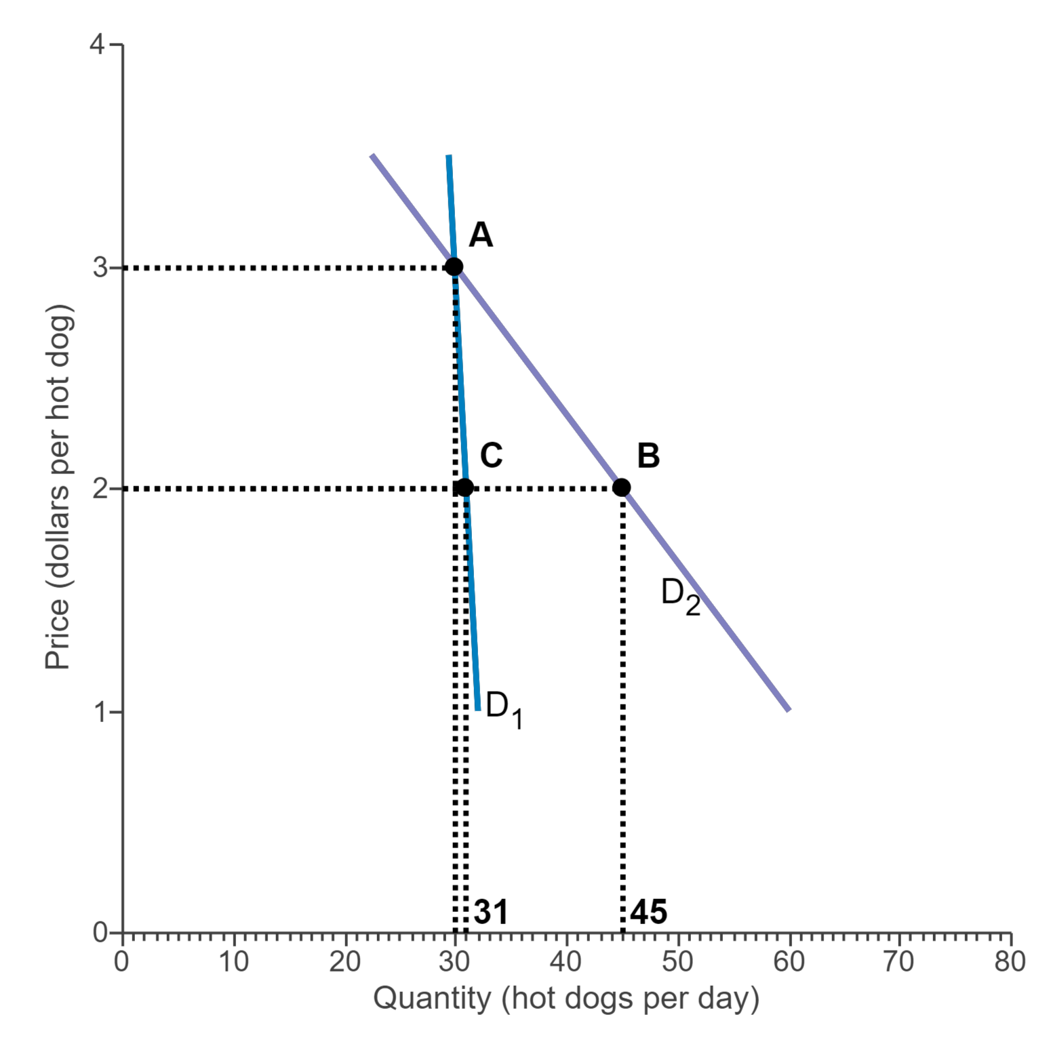
Active Learning Price Elasticity of Demand
You own a hot dog stand that you set up every day at lunch time.​ Currently you are selling hot dogs for a price of​ $3, and you sell 30 hot dogs a day.
You are considering cutting the price to​ $2. Calculate the price elasticity using the midpoint formula.
On the demand curve containing the points​ "A" and​ "B", the price elasticity of demand for a price cut from​ $3 to​ $2 is __________
On the demand curve containing the points​ "A" and​ "C", the price elasticity of demand for a price cut from​ $3 to​ $2 is __________

Slide 20
Other Elasticities
Income elasticity of demand: measures the response of Q^{d} to a change in consumer income
E_{I} > 0 implies “normal goods”
E_{I} < 0 implies “inferior goods”

Slide 21
Determinants of Income Elasticity
Income elasticities also differ from the short run to the long run.
For most goods and services—foods, beverages, fuel, entertainment, etc.— the income elasticity of demand is larger in the long run than in the short run.
For a durable good, the opposite is true. The short-run income elasticity of demand will be much larger than the long-run elasticity.

Slide 22
Other Elasticities
Cross-price elasticity of demand: measures the response of demand for one good to changes in the price of another good
E > 0 implies “substitutes”
E < 0 implies “complements”

Slide 23
Other Elasticities
Price Elasticity of Supply: measures the response of supply of one good to changes in the price of the good
Will always be E > 0

Slide 24
Determinants of Supply Elasticity
The more easily sellers can change the quantity they produce, the greater the price elasticity of supply.
For many goods, price elasticity of supply is greater in the long run than in the short run, because firms can build new factories, or new firms may be able to enter the market.
For some goods, price elasticity of supply is greater in the short run. (Example: secondary supply of metals)

Slide 25
Active Learning Price Elasticity of Supply
Suppose the demand curve for a product is given by:
Qd = 120 - 5P - 2I
where I is average income measured in thousands of dollars.
The supply curve is: Qs = 4P – 10
Assume that I = 20.
At a market equilibrium price of $10 and quantity of , what is the price elasticity of supply?

